Slide 1




Referral process
Referral form (more information may be needed from the school liaison)
Parent/carer meeting (another meeting may be needed to explore follow-up queries)
Teacher meeting
Classroom observation
Child or young person meeting
Sessions
At each stage of the referral process, the play therapist considers if the referral is appropriate, liaising with their clinical supervisor as more information is gathered from the child’s system.
Play therapy may not be considered appropriate as play therapy might not be the right intervention, the case may be outside the therapist's competency level, or it might not be the right time for therapy if the child is not physically and emotionally safe enough or if there are lots of ongoing changes.
Notes:
Initially, I will receive the referral form, which can be seen on the following slide. Then a referral meeting with parents or carers is arranged for me to learn more about the child or young person and to consider if play therapy would be an appropriate intervention. If it is, then written consent would be gained from those who hold parental responsibility, which is explained in subsequent slides. Next, a teacher meeting and classroom observation are arranged to learn more about the child or young person’s experience in school. Then a meeting is arranged with the child or young person and a trusted adult, usually a parent, where I will explain what play therapy is, how it will work for them, answer any question, and gain their assent to the play therapy sessions. The number of sessions can vary, and this is detailed in the final slide.

Slide 2

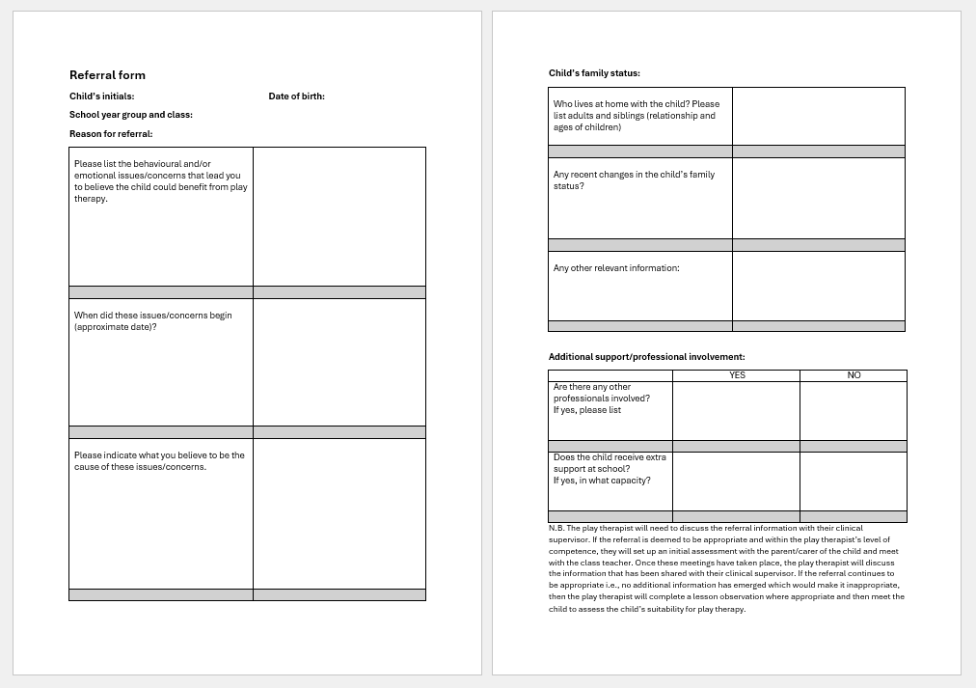

Referral form
Please fill this form out with as much detail as possible, as this will help the play therapist to fully consider this referral.

Slide 3

Consent
Who has parental responsibility?
Consent will need to be gained from those who have parental responsibility before the play therapy intervention can occur.
When parents are separated, with both parents having parental responsibility, both parents need to be involved in decision-making, regardless of the residence order.
If a social worker holds parental responsibility, it is still important to involve the other key adults in the child’s life in the play therapy process.
Adopted children would need to be referred elsewhere for play therapy through an adoption support agency which is registered with Ofsted.

Slide 4

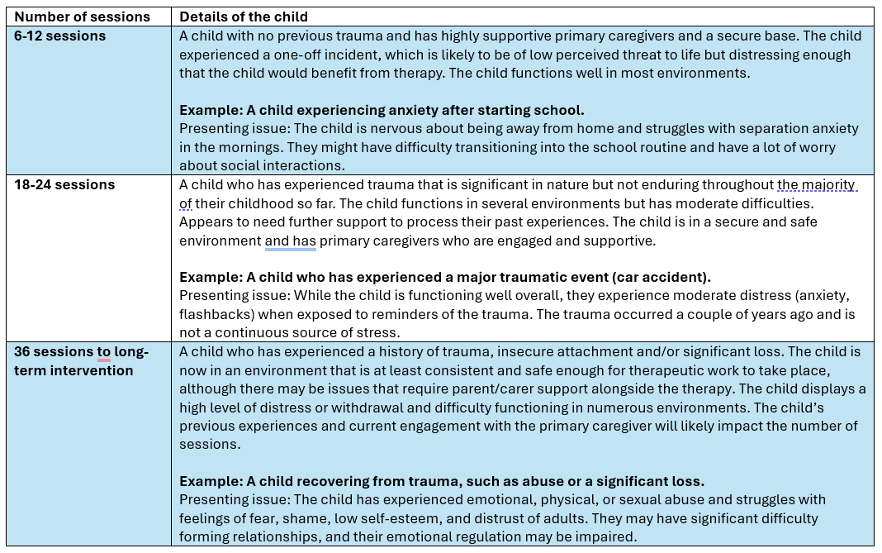

How long will the play therapy last?
The initial referral stage tends to be 5 hours and includes:
a parent/carers meeting (1-2 hours)
a meeting with school staff, usually the child’s class teacher (1 hour)
an observation in the classroom, ideally observing a structured lesson and an unstructured break time (1 hour)
a first meeting with the therapist, child, and a trusted adult, either a parent, carer or school staff (1 hour)
Sessions will begin after the referral stage if play therapy is deemed appropriate, and review meetings are held approximately every 6 weeks. The duration of play therapy is based on the needs of the child, and the play therapist will work closely with all involved parties (such as parents, carers, school staff and other professionals) to determine the need and the continued need for play therapy. Below is a rough guide for the potential duration of play therapy; however, it is essential to keep in mind that each case is unique, and therefore, the duration can vary.
For more information on pricing, please contact us directly.

